Slide 1
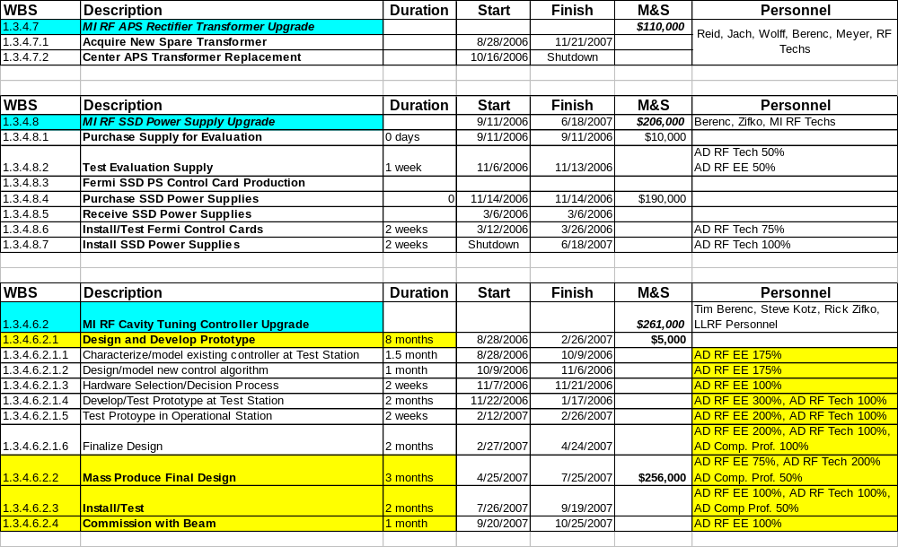
MI RF – CR Items Schedule

Slide 2
Concerns
Beam Loading Compensation Strategy for Proton Plan
  Limit Cavity De-Tuning
    New Controller = new design = risk
  Use Mode 1 Longitudinal Damper as necessary
    Not currently operational on present Slip-Stacking cycles
RF Resource Competition for Proton Plan
  Operations
  Booster SSD Upgrade
  ILC/SCRF: Meson, A0, etc.
  SNuMI: Phase I and Phase II
Aggressive Schedule
  Ideally - Need experienced personnel
  Practically – also training new personnel

